Slide 1
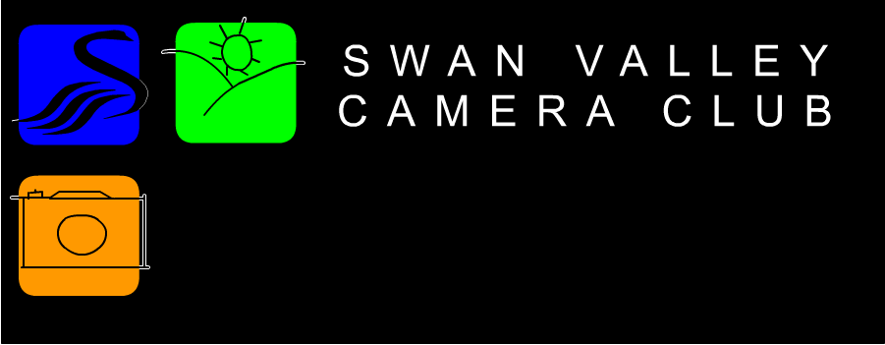
Workshop April 2014
“An introduction to Still Life”

Slide 2
Still life
A photograph of a pictorial arrangement of inanimate objects whether natural or manmade or a combination of both.
Synthetic scenes made up from models are described as "Table Top" and are excluded.

Slide 3
Natural Subjects
Natural objects are – Food, Flowers, Plants, Feathers, Rocks and Stones, Shells, Bones etc
Beware with rocks and stones that your image is not deemed a landscape
Beware with flowers and other plants that your image does not become a Macro

Slide 4
Artificial Subjects
Artificial Still Life objects are – Books, Vases, Glassware, Jars, Jewellery, Coins/Currency, Tools, Candy, Toys etc.
Beware with Toys/models, the common technique of posing these items to imitate a situation or scene IS NOT Still life, but is a separate discipline known as “Table Top”.

Slide 5
Where To Start
Still Life scenes are purposely set up and every last detail should be in the hands of the photographer.
You do not need $1000’s of equipment to take Still Life Images, nor do you need a big studio.

Slide 6
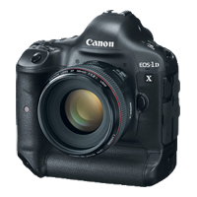
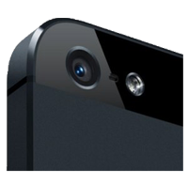
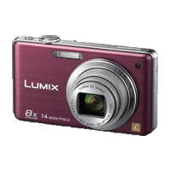
Minimum Equipment
Camera ☺

Slide 7
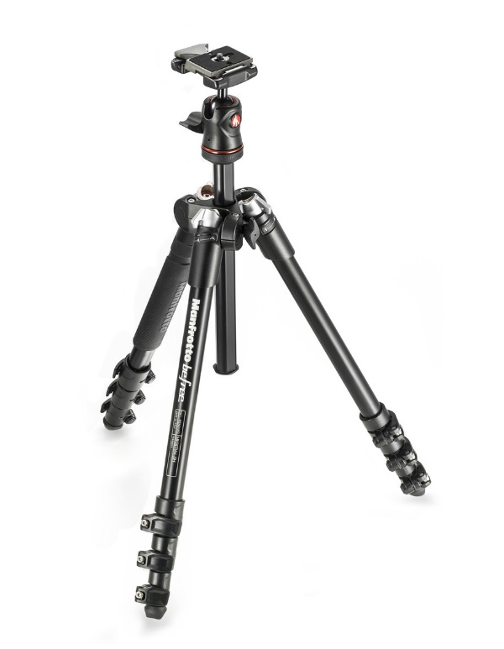
Minimum Equipment
Tripod – You can take still life images without one, but a good sturdy tripod gives you more fine control over the end result

Slide 8
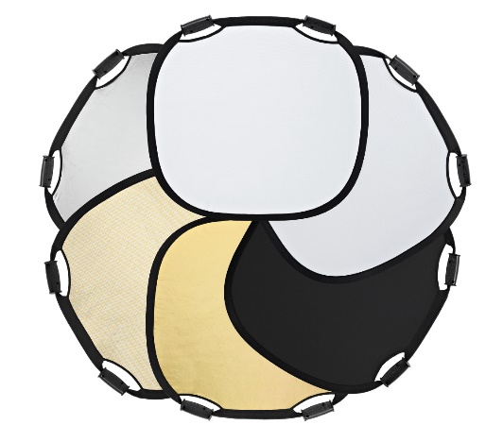
Minimum Equipment
A Table
A table cloth or paper
A background
Can be plain or patterned, either used as part of the atmosphere of the image or to balance it.
Reflectors / Light modifiers
(White Card, Tin Foil etc.)

Slide 9
Additional/Optional Equipment
Lamps
It is possible to use a couple simple lamps as your light source.
Flash
On camera flash can be used, but you WILL need reflectors to eliminate harsh shadows.
Off camera flash is better, use a Speedlight with a cable, wireless or light activated trigger.
Studio Lights.

Slide 10
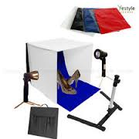
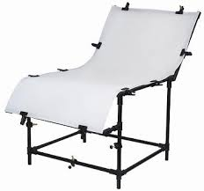
Additional/Optional Equipment
A Light Tent
A cheap and effective Still Life set up, available off EBay
A display Table
Now you are talking about serious Still Life photography, utilising a special table that helps control the light

Slide 11
Choosing The Subject
Use household objects.
There’s more to Still Life that bowls of fruit or vases of flowers.
Try to avoid reflective subjects unless you are comfortable with lighting control.

Slide 12
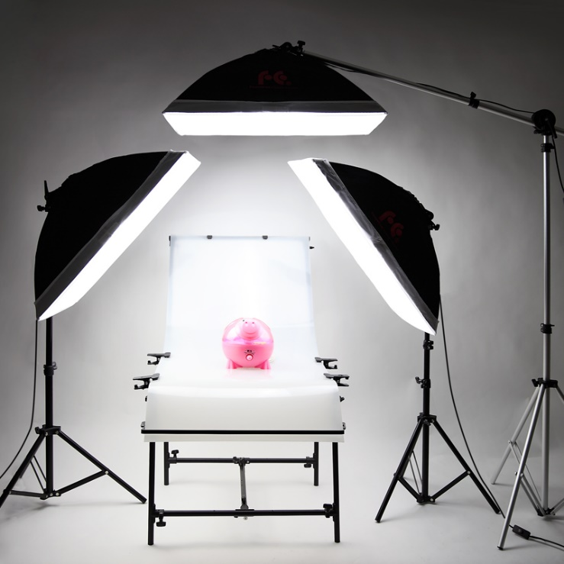
Lighting
Lighting is Key
Doesn’t have to be expensive
Natural Light is free.
Set up a nice table next to a window
Use reflectors to eliminate/reduce shadows

Slide 13
Lenses
Prime lenses are best (Quality)
Focal length 50 – 100mm
Image Stabilisation
Off if using a tripod.
Although newer lenses state IS can be left on when using a tripod it is better to switch it off.
IS can introduce the effect of movement as the IS system adjusts after the shutter is pressed causing blur.
On if hand holding the shot.

Slide 14
Use A Tripod
Remember, on a tripod, the camera is static
Take your camera off the tripod and look at alternative points of view
Different angle of view
Different elevation
Move your tripod setup to facilitate shots you see when moving around

Slide 15
Use A Tripod
Remember, on a tripod, the camera is static
Take your camera off the tripod and look at alternative points of view
Different angle of view
Different elevation
Move your tripod setup to facilitate shots you see when moving around

Slide 16
Backgrounds
Do not underestimate the background
Keep it simple – So it doesn’t become a key part of the image
Contrast the background with the subject
Compliment a key colour in the image
Think about the surface on which the shot is set

Slide 17
Composing The Shot
Composition will make, or break your shot.
Use the rules: -
Rule of thirds
Leading lines
Diagonals
Eliminate distractions
Vary the composition
Beware of negative space

Slide 18
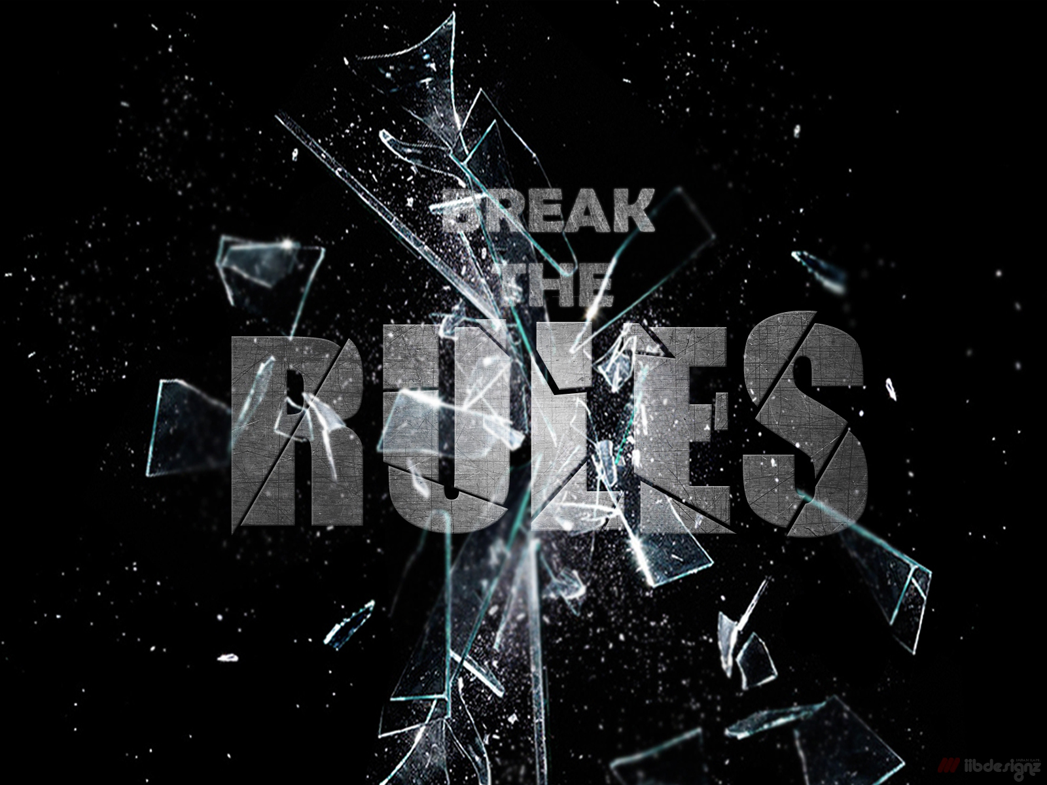
Composing The Shot

Slide 19
Take Your Time
Being in control of every aspect of the shot means you can take time to check, adjust and review before taking the shot.
Take a few shots, review the results and adjust the shot if it is not right
Getting lost in the shot? Take a break, come back to it in half an hour it will still be set up the same

Slide 20
Camera Settings
Exposure Mode – Manual
Focus Mode – Manual
Shutter Speed – 1/60th Second or slower
Aperture – F16 or F22
ISO – 100
Drive mode – Single shot
White Balance – Daylight
Lens – 50 – 100mm

Slide 21
Still Life Tips Summary
Still life puts you in total control of the shot, so take your time and look at every detail
Lighting is key, experiment with natural light as well as flash.
Use reflectors to fine tune lighting and control shadows
There is no excuse for a poorly lit or out of focus Still Life shot.

Slide 22
Practical Workshop
Now it is time to get your cameras and give Still Life a try.

